Slide 1
Aravinth S
NM Final Project

Slide 2
PROJECT TITLE
Earthquake-prediction-using-Machine-learning-models

Slide 3


AGENDA
PROBLEM STATEMENT
PROJECT OVERVIEW
WHO ARE THE END USERS?
SOLUTION AND ITS VALUE PROPOSITION
MODELLING
RESULTS
3/21/2024 Annual Review

Slide 4

PROBLEM STATEMENT
This project aims to predict earthquake magnitude and occurrence probability in California using machine learning models trained on historical earthquake data from 2017 to 2019. Challenges include preprocessing the dataset, feature engineering to identify relevant predictors, and selecting suitable algorithms (regression, classification, time series forecasting). Evaluation metrics such as mean squared error and accuracy will assess model performance, with hyperparameter tuning to optimize efficacy. Deployment of these models aims to support early warning systems and disaster planning, ultimately mitigating the impact of earthquakes on lives and infrastructure in California.
3/21/2024 Annual Review

Slide 5

PROJECT OVERVIEW
This project focuses on leveraging machine learning techniques to predict earthquake magnitude and occurrence probability in California using historical earthquake data from 2017 to 2019. The dataset contains information on earthquake events, including date and time of occurrence, geographic coordinates of the epicenter, depth, and additional seismic parameters. The main objectives include preprocessing the dataset, conducting feature engineering to identify relevant predictors, selecting appropriate machine learning algorithms, and evaluating model performance using metrics such as mean squared error and accuracy. Hyperparameter tuning will be employed to optimize model efficacy, with the ultimate goal of deploying these models to support early warning systems and disaster planning efforts in California.
3/21/2024 Annual Review

Slide 6

WHO ARE THE END USERS?
Emergency Response Agencies: Organizations responsible for managing disaster response and coordinating relief efforts, such as FEMA (Federal Emergency Management Agency) and local emergency management agencies, could utilize the earthquake prediction models to enhance preparedness and response strategies.
Government Authorities: Government agencies at the local, state, and federal levels, including city planners and policymakers, could benefit from the insights provided by the predictive models to inform land use planning, infrastructure development, and building code regulations aimed at reducing earthquake vulnerability.
Scientific Researchers: Seismologists, geologists, and researchers studying earthquake dynamics and seismic activity could use the predictive models to gain insights into earthquake patterns, trends, and contributing factors, thereby advancing scientific understanding and informing future research endeavors.
3/21/2024 Annual Review

Slide 7
WHO ARE THE END USERS?
4.General Public: Individuals living in earthquake-prone regions, such as residents of California, could benefit from early warning systems and risk assessment tools based on the predictive models, allowing them to take proactive measures to mitigate the impact of earthquakes on their lives and properties.
5.Insurance Companies: Insurance providers could use the predictive models to assess earthquake risk and determine insurance premiums, enabling them to better manage their exposure to potential earthquake-related losses and improve risk management strategies.
3/21/2024 Annual Review

Slide 8

YOUR SOLUTION AND ITS VALUE PROPOSITION
The solution proposed in this project offers significant value to various stakeholders by leveraging machine learning models to predict earthquake magnitude and occurrence probability in California. The key value propositions of the solution include:
Early Warning and Preparedness: By accurately predicting earthquake events, the solution provides early warning capabilities to emergency response agencies, government authorities, and the general public, enabling them to implement proactive measures and prepare for potential disasters, thereby reducing the loss of lives and property damage.
Risk Assessment and Planning: The predictive models aid in assessing earthquake risk at both the individual and community levels, allowing city planners, policymakers, and insurance companies to make informed decisions regarding land use planning, infrastructure development, building codes, and insurance premiums, thereby reducing vulnerability to earthquake-related hazards and minimizing economic losses.
3/21/2024 Annual Review

Slide 9
YOUR SOLUTION AND ITS VALUE PROPOSITION
3.Scientific Insights: The solution offers valuable insights into earthquake patterns, trends, and contributing factors, facilitating scientific research and advancing our understanding of seismic activity, which can inform future research endeavors, disaster preparedness strategies, and risk mitigation measures.
4.Improved Resilience: By providing accurate predictions and insights, the solution enhances the resilience of communities, infrastructure, and economies in earthquake-prone regions, empowering stakeholders to better withstand and recover from earthquake disasters, ultimately fostering safer and more sustainable societies.

Slide 10
MODELLING
For this earthquake prediction project, we will employ four different machine learning models: Linear Regression, Support Vector Machine (SVM), Naive Bayes, and Random Forest. Here's how we'll approach the modeling process:
Linear Regression:
Model: We'll train a linear regression model to predict the earthquake magnitude based on features such as date and time of occurrence, geographic coordinates of the epicenter, and seismic parameters.
Training: We'll split the dataset into training and testing sets, fit the linear regression model to the training data, and evaluate its performance using metrics like mean squared error.
Prediction: After training, we'll use the model to predict earthquake magnitudes for unseen data points.
Support Vector Machine (SVM):
Model: We'll utilize SVM, a supervised learning algorithm, to classify earthquake events and predict their magnitudes.
Training: We'll preprocess the data, including feature scaling, and train the SVM model on the training dataset. We'll explore different kernel functions (e.g., linear, polynomial, radial basis function) to find the best fit.
Evaluation: We'll evaluate the SVM model's performance using classification metrics like accuracy, precision, recall, and F1-score.
10

Slide 11
MODELLING
3.Naive Bayes:
Model: We'll apply the Naive Bayes algorithm, a probabilistic classifier, to predict earthquake occurrences and magnitudes based on the given features.
Training: We'll train the Naive Bayes model on the preprocessed dataset, considering the assumption of feature independence.
Evaluation: We'll assess the model's performance using classification metrics and compare it with other models to determine its effectiveness in earthquake prediction.
4.Random Forest:
Model: Random Forest, an ensemble learning technique, will be employed to build a predictive model for earthquake magnitude and occurrence probability.
Training: We'll train multiple decision tree classifiers on random subsets of the dataset and aggregate their predictions to improve accuracy and reduce overfitting.
Evaluation: We'll evaluate the Random Forest model's performance using metrics such as accuracy, precision, recall, and F1-score, and compare it with the other models to determine its effectiveness in earthquake prediction.
11

Slide 12
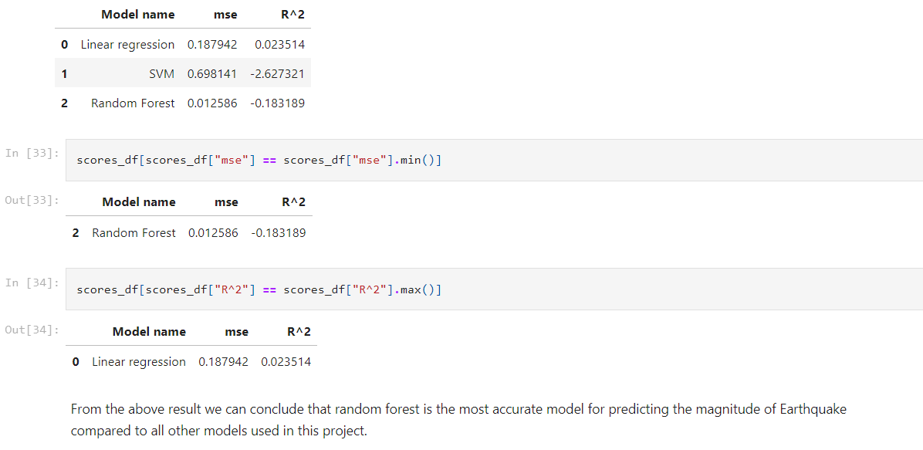
RESULTS
https://github.com/Aravinths132003/NM/blob/main/EDA_J_Component.ipynb
12

Slide 13
THANK YOU

